Slide 1
Best Practices for Building an Innovative and Cost-Effective Robotics Program - 17 Years of Trial-and-Error
Chris d. Odom, George School
ADVIS technology/innovation retreat @ Archmere academy
2.11.19
www.pcrduino.com/workshops/
Notes:
Hi my name is Chris Odom, and I am very pleased to be talking to you today about the 17-year evolution of my Physical Computing & Robotics course at George School

Slide 2
Chris Odom, Robotics & Physics Teacher / Textbook Author, George School "STEAM" (Science, Technology, Engineering, Art, and Mathematics) is a well-known buzzword in education today. Most schools have no problem satisfying the Science, Art, and Math portions of the acronym, but often struggle to include Technology and Engineering into the equation. Perhaps the biggest hurdle is finding a coherent curriculum that integrates them all while maintaining the rigor deserving of each discipline. This workshop will describe the 17-year development of the Physical Computing & Robotics curriculum at George School. I will explain why the popular FIRST, LEGO, and VEX platforms did not resonate with me, and how our thriving program of 60 students per year can be maintained for an annual cost between $0 and $100 per student. I will highlight our failures and successes, which have led to the use of the Patton Robotics platform and the development of textbooks and a curriculum that fully integrates art, science, mathematics, and engineering under the technology envelope.
Participants will have access to curricular materials used in our PC&R course, as well as a list of supplies that keeps costs low while providing every student with their own scalable, autonomous robotics platform. The benefits of in-house hackathons and collaborations between students and across disciplines will be provided. Finally, participants will learn how a rigorous STEAM course that provides a pathway to future endeavors in college and in the workplace can be fun and attractive to students without being flashy and gimmicky. Middle School, Upper School, Administrators
Notes:
A reminder of what I said I would discuss today. Just to keep me honest.

Slide 3
File Locations
Download this PowerPoint file here:
www.pcrduino.com/workshops/
Download my PC&R Curriculum files here:
www.pcrduino.com/resources/
Notes:
Feel free to download the PowerPoint if you want to take notes as we go.

Slide 4
My Assumptions
You will stop me and ask questions as I go!
When I say “robotics” I also mean engineering, embedded controller programming, mechanical engineering, electronics, fabrication, and design. I will use it as a catch-all term for these individual disciplines.
Few schools have a comprehensive robotics program.
Many schools have a robotics club.
Few schools have a fully-equipped robotics lab space.
School’s are hungry to build a cohesive STEM/STEAM program.
Notes:
Also time for Q&A at the end
But if you have a pressing Q, ask it!
It’s more fun that way.
Certainly stop me if I have said something that you don’t understand.
Agreed?
STEM is Science, Technology, Engineering, and Mathematics.
STEAM is STEM with Art.

Slide 5
About Me
Former atmospheric physicist and rocket scientist with NASA’s sounding rocket program.
Started writing code in 1982 after I saw the movie Tron.
Coding was an essential part of my BS, MS, and PhD work in experimental physics and astronomy. Never took a course.
Undergraduate work at Millsaps College and graduate work at Clemson University.
Passionate about education. Teaching for 30 years; from Middle School to Grad School.
George School teacher since 2002.
Notes:
Never played a video game after that.
There were no classes at my school. In fact, I had the only computer at my school, which opened all kinds of opportunities for me.
I have never taken a computer course – was always ahead of where my schools were. 100% self taught. And it is doable in this field. In grad school, I did learn numerical modeling in my Math Methods course.
I prefer the energy of young students.

Slide 6
How I Imagine YOU
Expert robotics teachers with a decade of experience looking to compare their methods and equipment with another’s.
Educators with some robotics experience who are looking to see what’s new or to ascertain if their path is still valid.
Teachers with little to no experience and are exploring what it takes to get into embedded controller education.
Teachers with little to no experience who were forced to attend by your school.
Notes:
I imagine that we have people in the audience who are:
Hopefully it is not the latter, but ironically, it is why I started down this path.
Should we raise a hand?

Slide 7
Keep this in mind…
There is no way to cover everything (or hardly anything) today.
I hope to start a dialog and meet like-minded people who share my excitement for STEAM education.
I want to share how I have used the power and possibilities of physical computing and embedded controller systems at George School.
If I can be a resource, then great!
I hope you will be a resource for me!

Slide 8
Physical Computing: Desktop Computing on Steroids
Use the same code as desktop applications, but use it to control physical devices.
Physical computing is about controlling devices other than a computer. Things like: LEDs, buzzers, servomotors, DC motors, relays, and other actuators.

Slide 9
Physical Computing: Sensors
Physical computing is also about gathering information from sensors and other input devices such as keyboards, buttons, and switches. What we can sense today is incredible: temperature, light, force, flexion, range (distance), rotation, acceleration, magnetic field, voltage, current, moisture, fire, CO, pH, turbidity, conductivity, GPS, infrared, UV, muscle contraction, vision, … the list goes on and on and on.
Sensors are typically inexpensive and often come ready to plug in. However, it is fun to build your own, too!

Slide 10
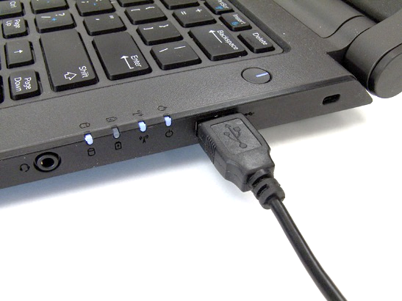
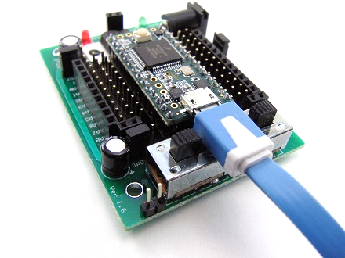
Coding Process for the Embedded Controller
Code is written on the desktop/laptop computer using an IDE, such as Arduino. To appeal to the artist in each of us, Arduino calls computer programs “sketches”.
The language can vary, but is often C-based. (Arduino C, e.g.)
The code is compiled by the computer (via the IDE). Because the computer does the compiling, the robot brain can be small, fast, and inexpensive.

Slide 11
Code Tutorial: Hello World
// hello.ino
// by c.d.odom on 5.4.18
void setup() {
// put your setup code here, to run once:
Serial.begin(9600); // set baud rate for Serial Monitor
}
void loop() {
// put your main code here, to run repeatedly:
Serial.print("Hello"); // print message to screen
delay(500); // pause for 500ms (0.5s)
}
Notes:
Comments are for the human reader’s benefit only.
Commenting is an excellent habit to form, but to save time, you may want to skip them here if you get behind.

Slide 12
Verify
Verify the code now, via Sketch >> Verify/Compile
This will check for code errors
No microcontroller needed for this step

Slide 13
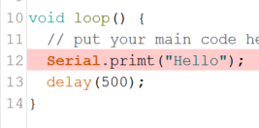
Got Errors?
If there are errors, fix them now. We have folks to help!

Slide 14
Coding Process for the Embedded Controller
The compiled (machine) code is downloaded to the microcontroller, usually via a USB programming cable.
Once the code is on the microcontroller, it can be executed repeatedly – no computer is necessary.
The code remains in the EEPROM (memory) of the microcontroller forever.
New code can be written and uploaded to the robot brain practically as many times as desired. Old code is overwritten.
Notes:
Code is written on the desktop/laptop computer using an IDE, such as Arduino. To appeal to the artist in each of us, Arduino calls computer programs “sketches”.
The language can vary, but is often C-based. (Arduino C, e.g.)
The code is compiled by the computer (via the IDE). Because the computer does the compiling, the robot brain can be small, fast, and inexpensive.
The compiled (machine) code is downloaded to the microcontroller, usually via a USB programming cable.
Once the code is on the microcontroller, it can be executed repeatedly – no computer is necessary.
The code remains in the EEPROM (memory) of the microcontroller forever.
New code can be written and uploaded to the robot brain practically as many times as desired. Old code is overwritten.

Slide 15
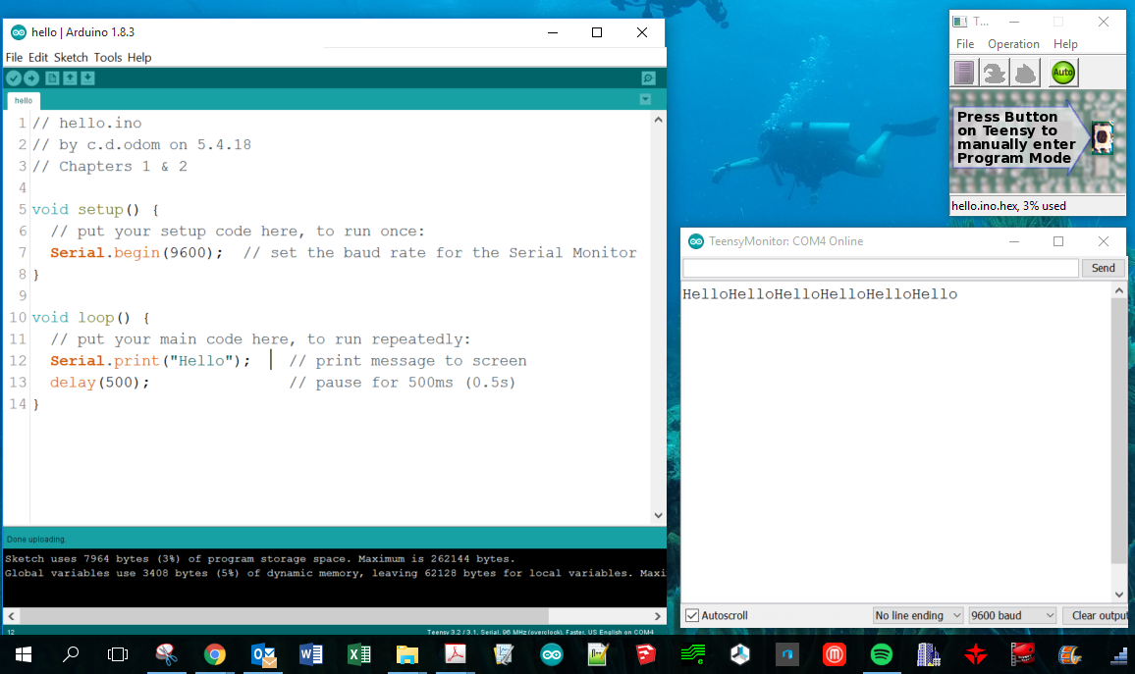
View the Output
To view the program’s output, open the Serial Monitor via Tools >> Serial Monitor
Arrange windows so you can code window, the Serial Monitor, and Teensyduino window:

Slide 16
Code Tutorial: Hello World
Make one tiny change to your code and re-upload:
Serial.println("Hello"); // print message to screen
Notes:
Code is written on the desktop/laptop computer using an IDE, such as Arduino. To appeal to the artist in each of us, Arduino calls computer programs “sketches”.
The language can vary, but is often C-based. (Arduino C, e.g.)
The code is compiled by the computer (via the IDE). Because the computer does the compiling, the robot brain can be small, fast, and inexpensive.
The compiled (machine) code is downloaded to the microcontroller, usually via a USB programming cable.
Once the code is on the microcontroller, it can be executed repeatedly – no computer is necessary.
The code remains in the EEPROM (memory) of the microcontroller forever.
New code can be written and uploaded to the robot brain practically as many times as desired. Old code is overwritten.

Slide 17
Microcontroller Handling Warnings!
These microcontrollers are quite robust, but they are not toys and can be damaged if care is not taken.
When the programming cable is plugged in, the microcontroller has power. Be careful that you don’t set it down on metal. Even an itty-bitty staple can short it!
Plug into a breadboard, use standoffs, or attach it to a robot.
Be careful of the micro USB connector! It pries off easily.
Don’t bathe with it.

Slide 18
Microcontroller Upload Warnings!
While the computer is downloading code to the microcontroller …
NEVER unplug the microcontroller!
NEVER upload more code!
Be patient! Wait for the software to tell you the code has been uploaded.
It seems that some of these issues have been resolved recently for Teensy 3.2 users, as the new boards are now made in the USA. These seem to be more robust and less susceptible to the above issues.

Slide 19
About George School
Quaker. Deliberate education of the whole person.
International. ~40 countries and ~20 states. Well Integrated.
Student body: Wide range of socio-economic backgrounds.
Boarding/Day: 55% board. Student time is highly constrained.
A liberal arts focus, with strong STEM/STEAM education. (2 Nobel Prize-winning scientists)
Robust AP and IB courses, with plenty of and non-AP and non-IB offerings.
Students are typically hardworking, creative, motivated, and kind.
As a result, most teachers stay for decades.

Slide 20
Technology @ George School
Definitely not a tech school.
Student skills in information technologies and engineering is quite limited. But awesome artists!
Only 5% of my students have any experience coding.
Few can identify an Allen wrench, Philips-head screwdriver, or Vernier caliper.
Students now must provide their own laptops.
Dual Platform: PC and Mac are fully supported.
Warning: More and more difficult to find non-blockbuster apps that run on a Mac. Emerging tech not written for Mac.
Notes:
Just so you know what kind of students I teach… Until recently, the school provided laptops for every classroom.
Mac issues: Some things work well: programming. Some work so-so: CAD, PCB fabrication. Some don’t work at all: Laser cutting

Slide 21
Assumptions about my Robotics Course
Year-long (3 terms).
Must be affordable (for the school and students).
Open to all sophomores, juniors, and seniors who meet the math prerequisite (~ Algebra 2 or Geometry with Trigonometry).
Accessible to a wide range of students of varying abilities. Mixed levels a must: Intermediate and Intensive.
Notes:
Do not have the facilities or personnel to offer multiple class levels
Prerequisites are rough and have a grade requirement as well.

Slide 22
Evolution of GS Robotics – Beginnings
2002 - my first year at George School.
One computer science class:
Desktop Business Computing with Visual Basic.Net (VB.Net)
6 students (understandably). One girl. One student of color.
First: Change from Business Computing to general coding with VB.Net:
Math, Science, Games, Sports, and, yes, Business apps
Notes:
Desktop computing

Slide 23
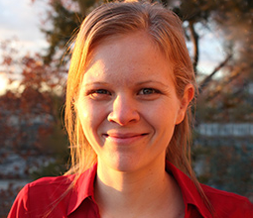
Evolution – Kylan Turner & Brian Patton
The lone female in that first class was a senior named Kylan Turner. Math was not her favorite subject and saw programming as the lesser of all other math evils.
At that same time, Brian Patton – substitute teacher and President of Patton Robotics, LLC – introduced me to his patented facially expressive robot ESRA, which could be controlled with VB.Net code.
Notes:
Patton Robotics and Robodyssey Systems were one of the first educational robotics companies in the world.
Relate story of Kylan’s first interactions at U Pitt neuroscience. And her first paper. And Yale.
Distribute article http://www.pcrduino.com/wp-content/uploads/about/Kylan%20Turner%20web_v77n3december05%20p8-31.pdf

Slide 24
Evolution of GS Robotics – Kylan’s Progress
Kylan was not a terribly motivated desktop programming student until she realized she could apply classroom VB.Net coding and Brian’s ESRA to help a little boy with autism who lived in her neighborhood.
After that, everything changed. Kylan became highly motivated, writing programs for ESRA that would help the young boy with his arithmetic and communication skills.
She went on to study psychology and neuroscience at the University of Pittsburgh, and is now a board certified Behavioral Analyst and professor at Simmons University.
Read Kylan’s story: www.pcrduino.com/wp-content/uploads/about/Kylan_Turner_Georgian05.pdf .
Notes:
Relate story of Kylan’s first interactions at U Pitt neuroscience. And her first paper. And Yale.
Distribute article http://www.pcrduino.com/wp-content/uploads/about/Kylan%20Turner%20web_v77n3december05%20p8-31.pdf

Slide 25
Evolution of GS Robotics – Kylan’s Influence
Kylan’s story has stuck with me because it was so impactful and became the inspiration for today’s GS Robotics program.
Project-based learning is incredibly powerful.
Recruit out-of-the-box, creative thinkers with open arms – even (especially) if they don’t fit the typical profile of a technology geek.
Coding opens doors that would remain firmly closed otherwise.
Solidified in me that “schooling should never get in the way of one’s education”! There are lots of ways to teach material.
The start of a long collaboration with Brian Patton.

Slide 26
Evolution of GS Robotics – The Early Course
I felt compelled to create a robotics course, starting in 2003. No curriculum was available. Course had to be created from scratch.
I know I wanted:
A year-long course, not a club or after school activity.
The new robotics course had to cover a wide range of topics, including coding, electronics, and robotics. One robot per student. The robot must evolve with the course.
Real coding, real engineering for the real world. Off-the-shelf components; no proprietary equipment. No drag-and-drop coding.
Autonomous robotics – nothing remote controlled. Teach to the future.
An affordable option – no budget!
Notes:
No AP, IB, or other curriculum. Still no curriculum available except mine.

Slide 27
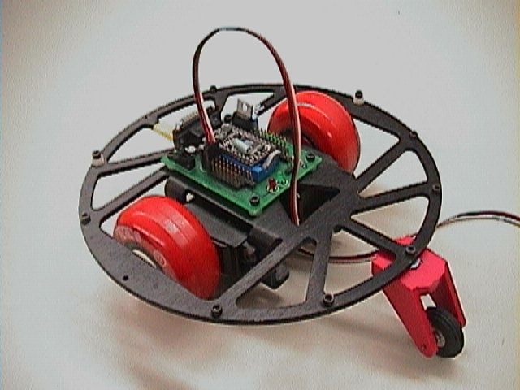
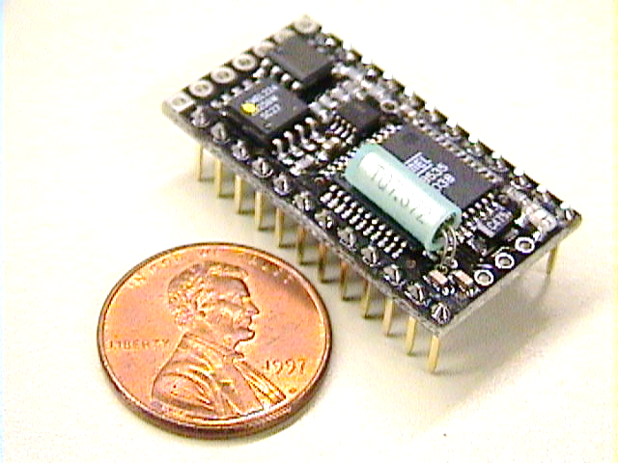
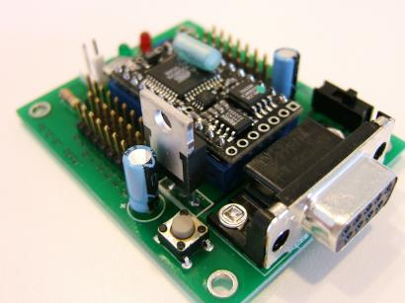
Evolution of GS Robotics – Decisions
But which platform? FIRST, LEGO Mindstorms, BOE-BOT, VEX, BX-24/Mouse?
All are great, but after a much research, only one system ticked all my boxes: Mouse robot with BX-24 microcontroller brain and RAMB Motherboard. (Brian Patton VP of company).
Notes:
I am not knocking any of these programs. They are all great for what they do, but they just were not right for me or GS at the time.

Slide 28
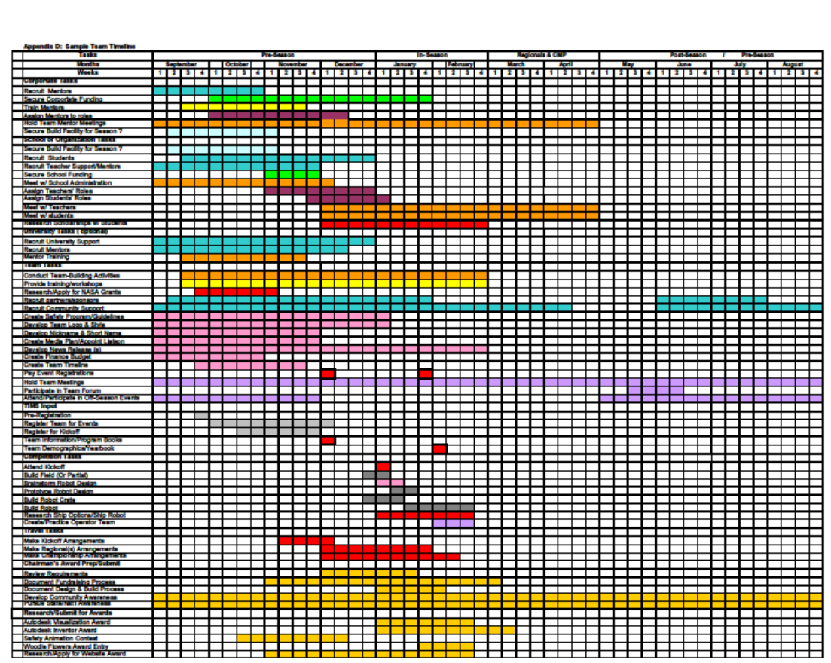
Evolution of GS Robotics – Why Not First
September 1
August 31
Too expensive
Students must share one robot
Too little time on robotics. (See sample timeline.)
Little autonomy.
Final project decided for me.
“Build robot” (7 weeks)
Notes:
Here’s a sample “Team Timeline”.
Robots are primarially RC controlled.

Slide 29
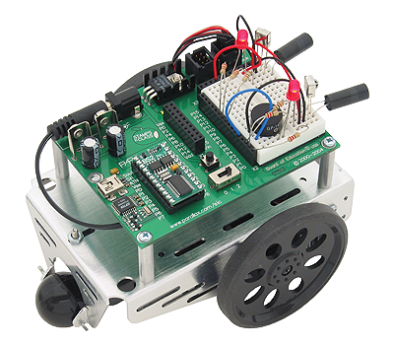
Evolution of GS Robotics – Why Not BOE-BOT?
Old processor, outdated technology (BASIC Stamp – still used today!)
Not expandable. Robot does not evolve with the course.
$200 for thin, sheet metal chassis and plastic wheels; unlikely to hold up over time.
Notes:
Here’s a sample “Team Timeline”.

Slide 30
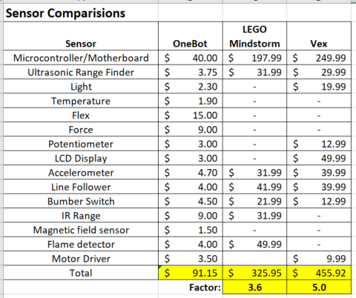
Evolution – Why Not VEX or LEGo?
Expensive.
Proprietary hardware and software. Not real-world enough.
Limited expandability.
Limited number of available sensors.
Sensors/Controllers cost 3.6-5.0 times more.
www.pcrduino.com/wp-content/uploads/Workshops/sensor comparison.xlsx
Notes:
Here’s a sample “Team Timeline”.

Slide 31
Robot Platforms: OneBot, LEGO, VEX, First, Boe-Bot
Needed expandable platform with infinite growth potential. (cf. LEGO, VEX, Boe-Bot)
Requires no proprietary (i.e. expensive) components. (cf. LEGO and VEX)
Requires real coding. A marketable skill. No drag and drop. (cf. LEGO and VEX (with Blocky))
Affordable. Allows for one student per robot. Students don’t have to fight for a chance to work on one big robot. (cf. FIRST and VEX)
DIY Kit. Fosters creation, not simply building. (cf. Boe-Bot)
Designed for autonomous robotics – not remote control. (cf. FIRST and LEGO)
Superior construction (durable air craft aluminum, lots of mounting options). (cf. Boe-Bot and LEGO)
Patton Robotics is focused on education. (+ Brian is a genius and all-around great guy.)

Slide 32
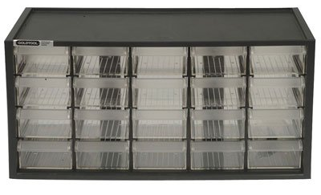
Evolution of GS Robotics – The Early Course
Started with twelve students and six loaner BX-24 bots from Brian Patton. We’d destroy them, he’d redesign them.
Students shared robots (2 per bot). Classes shared robots (1 set per 2 classes).
Only one box of components.
Shared classroom with chemistry.
One set of shared laptops per floor in science.
BX-24 controllers with BasicX language.
Lecture-based, so all students moved at same pace.
Within three years: 2 classes and 32 students + waiting list.
Notes:
Students now responsible for providing their own laptops.
Moving at the same pace was nice! I was in control. It was also bad pedagogy!
I used the BX-24 controller in my research at Clemson, so I knew it well.

Slide 33
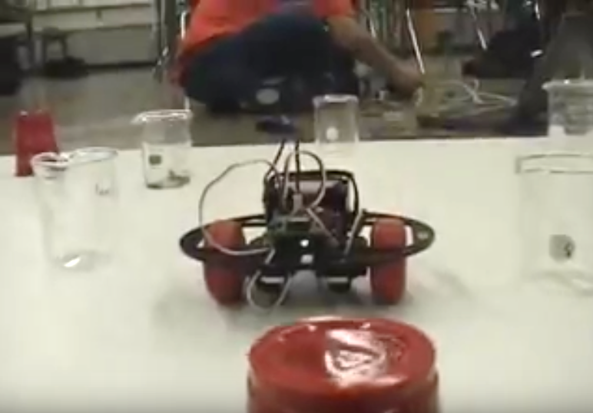
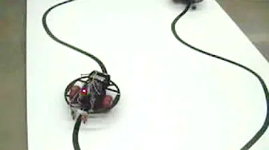
Evolution of GS Robotics – The Early Course
Not a lot of material covered in the early years – even in three terms. Limited by lecture style and speed of student group.
Primitive facilities, limited equipment, basic assignments, but great fun! (We didn’t know any better.) Students started pushing the envelope.
Lots of “dumb” dead-reckoning robots.
Course culminated with autonomous robots.
Early YouTube videos:
Robot Race: https://youtu.be/iv5yEhsUt94?t=4
Obstacle Course: https://youtu.be/cWlK8lbHUCA
Line Following: https://youtu.be/cjrybua2zKU
Notes:
Students now responsible for providing their own laptops.
Moving at the same pace was nice! I was in control. It was also bad pedagogy!

Slide 34
Evolution of GS Robotics – The Early Course
School was hesitant to fund classroom set of robots.
Seen as “expensive” until I pointed out that a classroom set cost only as much as one of the eighteen computers in the cart. Roughly $200 per robot kit.
Reusable, robust, and expandable robots. (Still in action today!)
In three years, enrollment in Robotics grew 500%!
The meager investment has paid for itself 1000x over. (Some students come to GS just for the Robotics program.)
Notes:
Students now responsible for providing their own laptops.
Moving at the same pace was nice! I was in control. It was also bad pedagogy!
Today, enrollment in Robotics is at 50 students, or 700% increase.

Slide 35
Evolution of GS Robotics – The Early Course
Slow accumulation of gear. Bits and pieces; dibs and drabs.
Be patient and mindful of the money! Time = Money, so buy high quality stuff!
Patton Robotics – best bet for robotics educational products!
Sparkfun
RobotShop
Adafruit Industries
The more stuff, the more diverse the lessons and the better the student projects.
Notes:
To be clear, I am in no way financially or otherwise affiliated with Patton Robotics, LLC – a name that will come up often.

Slide 36
Evolution – The First Textbook & Curriculum
It was immediately evident that lecture-based learning was not the way to go. Fast students were angry. Slow students were frustrated. One student was happy.
Physically and mentally demanding to teach the curriculum. The pace problem.
I decided to write a robotics around the BX-24 microcontroller so I wouldn’t have to talk so much and wouldn’t forget what I knew.
I had written physics books, but I was trained in that field. I had never even taken a programming course; who was I fooling?
But the book was a necessity, for there were no robotics textbooks or curricular materials out there.
Started developing more a comprehensive curriculum and more sophisticated projects. Let students propel and scaffold the program!

Slide 37
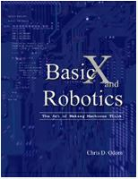
Evolution – BasicX and Robotics
BasicX and Robotics was published in 2005; a successful disaster.
Book had positive and immediate effect on students’ happiness, retention, and speed.
Students read the book and paced themselves. Solved the pace problem.
World’s only robotics textbook, and even colleges and universities used it.
However, topics were not completely covered and book’s flow was bad.
Notes:
I should mention that students were involved in the process of all my books. Cover art, photography, clip art, and especially editing.

Slide 38
Evolution – BasicX and Robotics
I considered new print-on-demand technology, but $100/book. Therefore, traditional publishing (5000 copies).
Then NetMedia stopped making the BX-24 microcontroller, and overnight my brand new book was obsolete. I would not make that mistake again.
6-months after the printing, print-on-demand became viable. Another painful memory.
Nevertheless, books were used for a decade.
Notes:
I should mention that students were involved in the process of all my books. Cover art, photography, clip art, and especially editing.

Slide 39
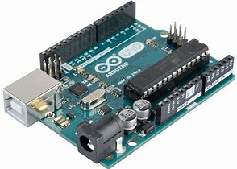
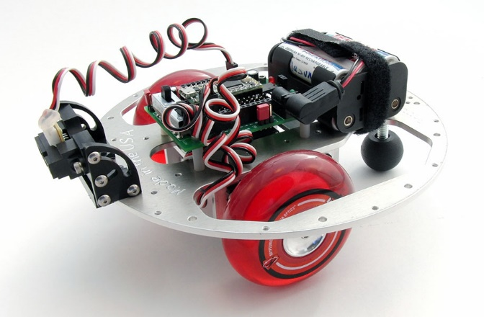
New Kids on the Block: Uno, Teensy, & OneBot
Ten years after the publication of BasicX and Robotics, my textbook and the BX-24 controller were in their final days. It was time for an upgrade.
At that time, two hot new 5-volt AVR development boards came on the market: the Arduino Uno and the Teensy 2.0 from PJRC. These were both easy to use and easy to program with the Arduino IDE.
Patton Robotics developed a new PRT motherboard for the Teensy 2.0 and a new robot – the OneBot – for both the Teensy 2.0 and Arduino Uno.
Notes:
Arduino is an Italian company, and PJRC is in the USA.
Arduino is confusing: it is a company, a development board, and an IDE.
AVR = Alf and Vegard’s RISC processor. (RISC = reduced instruction set computer) One of the fiirst to use on-chip flash memory to store programs
IDE = Integrated Development Environment. (Fancy name for programming environment.)

Slide 40
New Textbooks; A Bullet dodged
Three months into writing my new textbooks, Arduino and PJRC came out with new, efficient, and fast 3.3-volt ARM controllers.
Eager to avoid backing another dying technology, I dropped the older 5V AVR systems from my textbook and focused solely on the new Teensy 3.2 and Arduino Due development boards.
ARM 3.3V architectures are the future! Just last year, Apple converted all their phone to ARM processors. (We were four years ahead of Apple!)
Notes:
ARM = Advanced RISC Machines. (RISC = reduced instruction set computer)
9ns processing speeds!
I should mention that students were involved in the process of all my books. Cover art, photography, clip art, and especially editing.

Slide 41
Oh No, no more Uno?
The Uno and Teensy 2.0 are still commonly used today, but the days are numbered for the older 5-volt AVR systems.
It is likely that most schools still use the Arduino Uno in their robotics programs.
Fortunately, I missed jumping on this band wagon while the BX-24 was slowing dying.
I think these AVR controllers will be supported for a while, but most new devices and sensors are 3.3-volt.

Slide 42
ARM Wins!
For multiple reasons, I prefer the ARM architecture:
Processing speed
Unbelievable math engine
More efficient (3.3V)
Higher resolution (13-bit practical)
But most importantly: every physical computing device is moving in that direction. It will still be viable in ten years!
{ARM stands for Advanced RISC Machines.
RISC stands for Reduced Instruction Set Computer.}

Slide 43
Microcontrollers: PIC, AVR, & ARM
Feature | PIC | AVR | ARM
Common Products | Basic Stamp (BS1, BS2px) | Teensy 2.0 Arduino Uno | Teensy 3.2 Arduino Due
Release Date | 1993 (very old) | 2010 (old) | 2012 (new)
I/O Voltage | 5.0 V | 5.0 V | 3.3 V (Teensy is 5-volt tolerant)
Speed | 4 MHz | 16 MHz | 72-96 MHz
Resolution | 8-bit | 8-bit (typical) | 16-bit (13-bit practical limit)
Future Use | Unlikely. | Maybe? | Absolutely!
Flash Memory | 256 Bytes – 16 Kb | 32 Kb | 256 Kb (Teensy 3.2) 512 Kb (Due)
I/O pins (Digital/Analog) | 8-16 | Teensy 2.0: (24/10) Uno: (14/6) | Teensy 3.2: (24/10) Due: (54/12)
Cost | $40 - $79 | $20 | $19 (Teensy 3.2) $45 (Due)

Slide 44
But Which ARM? Teensy 3.2 or Arduino Due?
The Teensy 3.2 and Arduino Due development boards both use the new, super-fast 3.3V ARM controller and both are programmed with the popular Arduino IDE. So which to choose?
Students familiar with Arduino encouraged me to switch to the Arduino Due development board.
Arduino boards are touted as being super-inexpensive, but the pin configuration is limiting if you want to use inexpensive off-the-shelf components. Otherwise, jumper wires or shields.

Slide 45
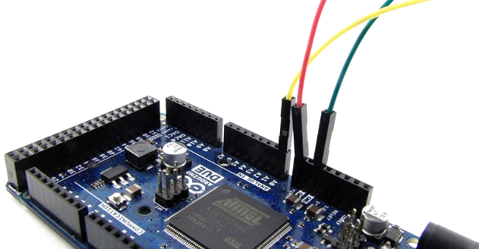
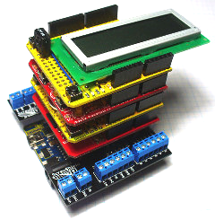
Arduino Due: Jumper Wires and Shields
Jumper wires are cheap and handy, but are easily disconnected.
Shields are devices that perform specific functions (e.g., control motors and LCD screens) when attached to an Arduino development board. But they are expensive and consume board space and resources.
Photo credit: John Boxall and www.freetronics.com

Slide 46
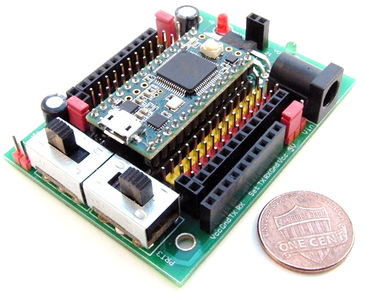
Teensy 3.2 and PRT3 Motherboard
Instead, I elected to migrate to the Teensy 3.2 controller and PRT3 motherboard for a number of reasons.
Teensy 3.2: pattonrobotics.com/products/teensy-3-2
PRT3: pattonrobotics.com/products/patton-robotics-teensy-motherboard-kit

Slide 47
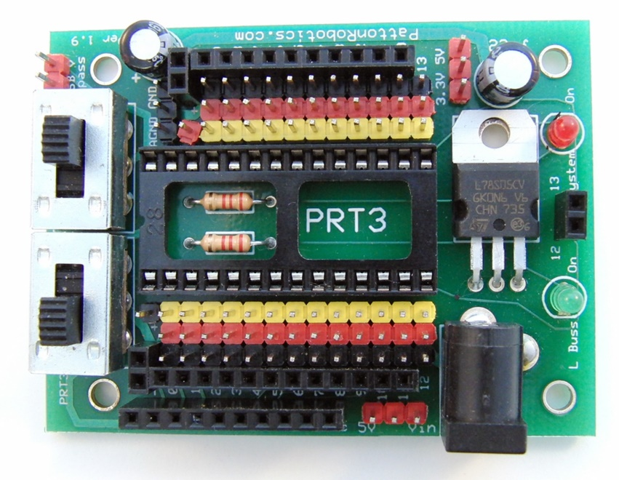
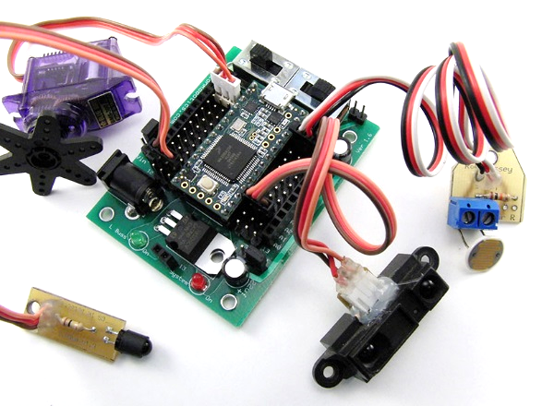
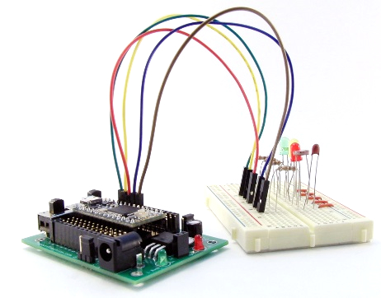
Teensy 3.2/PRT3 Pros
Inexpensive.
Small footprint.
Huge number of male and female header pin connections.
Plug-and-play functionality with off-the-shelf components, as well as jumper wires.

Slide 48
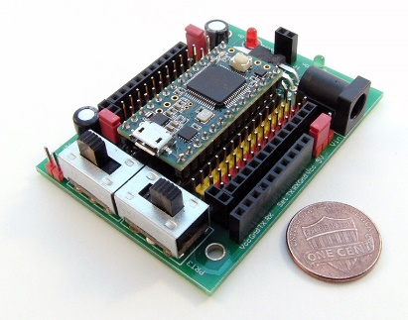
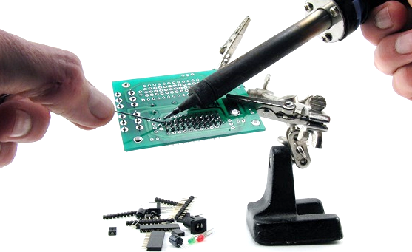
Teensy 3.2/PRT3 Pros
Two power switches (main and auxiliary). Handy!
Replaceable microcontroller. (Students will destroy them!)
Our students build and solder it from a kit. (Most schools don’t.)

Slide 49
Motherboards: PRT3/Teensy vs Arduino Due
Feature | PRT3 & Teensy 3.2 | Arduino Due
ARM Architecture? | ✓ | ✓
Replaceable Microcontroller? | ✓ | ✗
5-volt tolerant I/O pins? | ✓ | ✗
No Shields Required? | ✓ | ✗
Main Power Switch? | ✓ | ✗
Auxiliary Power Switch? | ✓ | ✗
Full Male and Female Headers? | ✓ | ✗
Plug-n-Play Capable? | ✓ | ✗
Direct Bluetooth/RF Comm Plug-In? | ✓ | ✗
Breadboard-able Microcontroller? | ✓ | ✗
DIY Kit Option? | ✓ | ✗
Available Power & Ground pins | 27/26 | 3/3
I/O Pins (Digital/Analog/PWM) | 24/10/10 * | 54/12/12
Footprint | 50 x 68 mm | 53 x 104
Retail Cost | $38-$45 (together) | ~$45 (currently sold out)
Made in the USA | ✓ | ✗
* For a TON of I/O pins and an SD card reader, consider the Teensy 3.5 and Patton Robotics Motherboard.

Slide 50
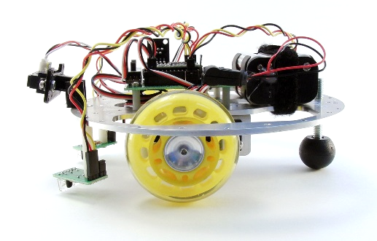
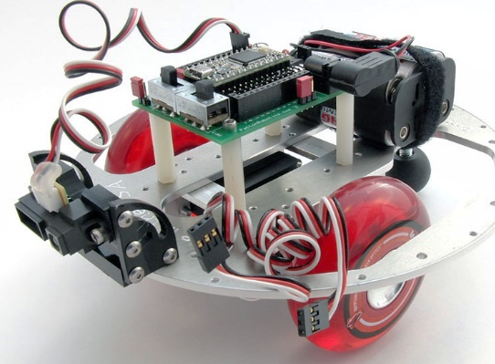
My Robot of Choice: The OneBot
I also settled on the OneBot educational platform from Patton Robotics as my robot of choice.
Indestructible, expandable, tons of tapped and thru-holes.

Slide 51
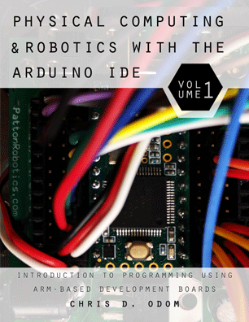
Physical Computing & Robotics Volume 1
While the Internet is full of information for specific help with coding, electronics, and robotics, it is rare for those sources to start at the beginning, and there's usually no coherent sequencing of topics.
Therefore, another textbook: Physical Computing & Robotics Volume 1.
PC&R Vol 1 teaches active learners how to write code for the Teensy 3.2 and Arduino Due embedded controllers. Essentially, it is a C-language programming text for self-regulated learners.
370 pages, 100’s of easy-to-follow code examples, 400+ images, 500+ Challenge Problems
Notes:
The internet is great for hobbyists, or if you have some prior experience, or if you know exactly what question to ask, or what specific task you need help with.
I should mention that students were involved in the process of all my books. Cover art, photography, clip art, and especially editing.

Slide 52
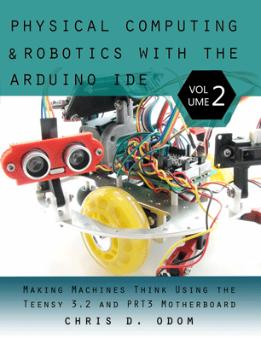
Physical Computing & Robotics Volume 2
PC&R Vol 1 teaches students how to program through active learning, and I would then teach them about electronics and robotics through lecture.
Again, this was a disaster, so a new book was a necessity.
I wrote Physical Computing and Robotics, Volume 2, which covers the hands-on electronics, mechanics, and robotics aspects of the course.
560 pages, 100’s of easy-to-follow code examples, 750+ images, 450+ Challenge Problems
Notes:
Again, the internet is great for hobbyists, or if you have some prior experience, or if you know exactly what question to ask, or what specific task you need help with.
I should mention that students were involved in the process of all my books. Cover art, photography, clip art, and especially editing.

Slide 53
Benefits of the Textbooks
Almost no lecture. Students read each book in a self-directed, self-paced manner – with minimum speed limits.
Promotes active learning strategies. Students independently follow the curriculum laid out on our Canvas LMS.
Reading assignments, worksheet, and Challenge Problems for each chapter are given for each chapter with suggested due dates.
We assume all the work will be accomplished in class. Little homework.
If students fall behind, they must do homework or consult with instructors to stay with the group. This is rare, but promotes self-regulated learning.
Books (no-lecture) allow students with a variety of skill sets to be enrolled in the same class.
Notes:
Again, the internet is great for hobbyists, or if you have some prior experience, or if you know exactly what question to ask, or what specific task you need help with.
I should mention that students were involved in the process of all my books. Cover art, photography, clip art, and especially editing.

Slide 54
GS Robotics Today
Year-long course. Three sections.
Each student has their own OneBot and toolbox.
Lab skills:
Soldering – practice boards, small circuits, PRT3 Motherboard
CAD, 3D Printing, and Laser Cutting
Machine tools
Students purchase their own Teensy, PRT3, and batteries. For an additional $12 they can leave with a 3D-printed or laser-cut robot.
Terms 1 & 2 = Volumes 1 & 2. Term 3 = Independent Projects.
Competitions and an Open House

Slide 55
Robotics budget
My budget is quite limited. Practically the same as it was in 2002 when we taught four physics classes and one desktop programming course.
With about the same budget, I now have to cover the expenses for 12 Physics classes, 3 Robotics classes, and Independent Study projects.
Again, I am patient (dribs and drabs), good with money, and buy quality stuff.
Robotics students purchase their own textbooks, motherboards (and solder them), Teensy 3.2 microcontrollers, and battery pack. (Physics students are not charged a lab fee.)
Notes:
They only buy one Teensy, unless they destroy several.

Slide 56
Robotics Course Dynamics 1
Students enroll at the Intermediate or Intensive level. All in the same class, so changing levels is easy.
Intensive students have about 30% more Challenge Problems to solve, have a few more pages to read in the texts, and are not allowed to “borrow” code from the Internet or another student.
Students submit work three ways:
Worksheets (by hand or electronically via Canvas LMS)
Code and code output is saved as a Word document and submitted electr5onically via Canvas. Can be graded by hand or with rubric.
Visually by instructors. E.g., verify that robot follows a line or stays on a table.
Notes:
Again, the internet is great for hobbyists, or if you have some prior experience, or if you know exactly what question to ask, or what specific task you need help with.
I should mention that students were involved in the process of all my books. Cover art, photography, clip art, and especially editing.

Slide 57
Robotics Course Dynamics 2
As soon as work is submitted, students may proceed to the next chapter.
Grading Robotics is still confusing to me. Easier early on: syntax issues, comments, bad variable names, submitted on time, etc. But we allow students to keep working until it works. They should check that the output is what is expected. If it is, how to grade? How to grade art? Suggestions?
Most of our students do well with this independence. Some with reading comprehension/speed issues might struggle a bit, but consultations help here.
Even students with severe learning differences can succeed if the scope of the course is further narrowed for them.
Notes:
Again, the internet is great for hobbyists, or if you have some prior experience, or if you know exactly what question to ask, or what specific task you need help with.
I should mention that students were involved in the process of all my books. Cover art, photography, clip art, and especially editing.

Slide 58
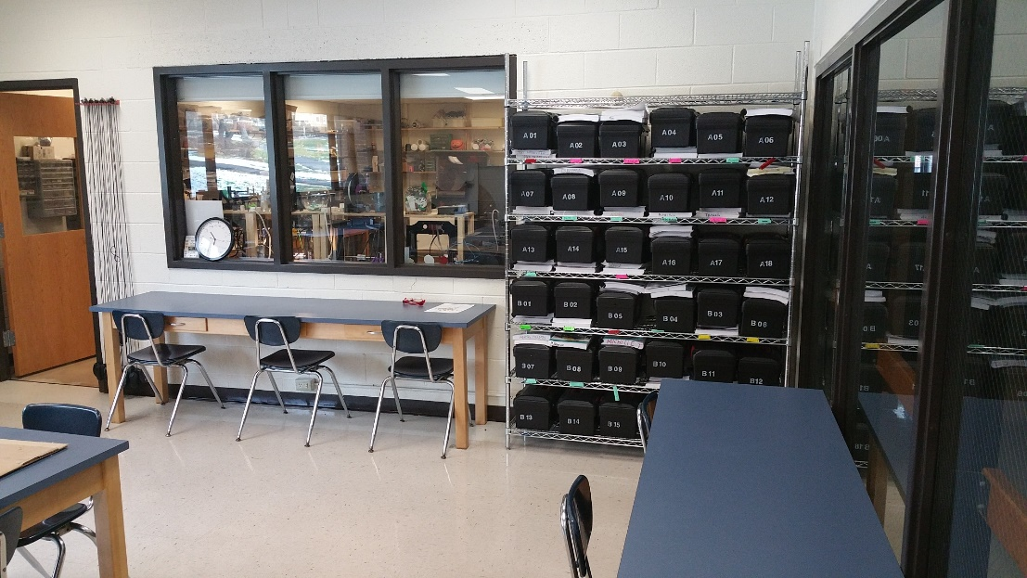
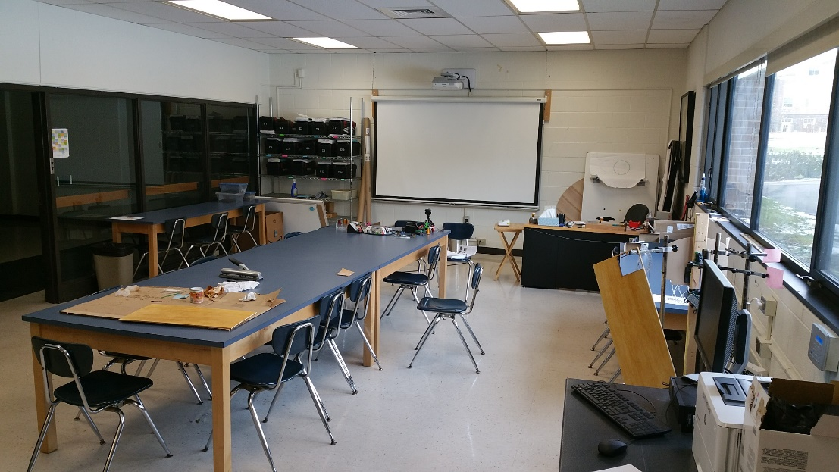
Lab Space
FISHBOWL Classroom
Programming desks
Toolboxes
Whiteboard and projector
Notes:
Fabrication and Integration of Software and Hardware Bot Operations Workshop Laboratory

Slide 59
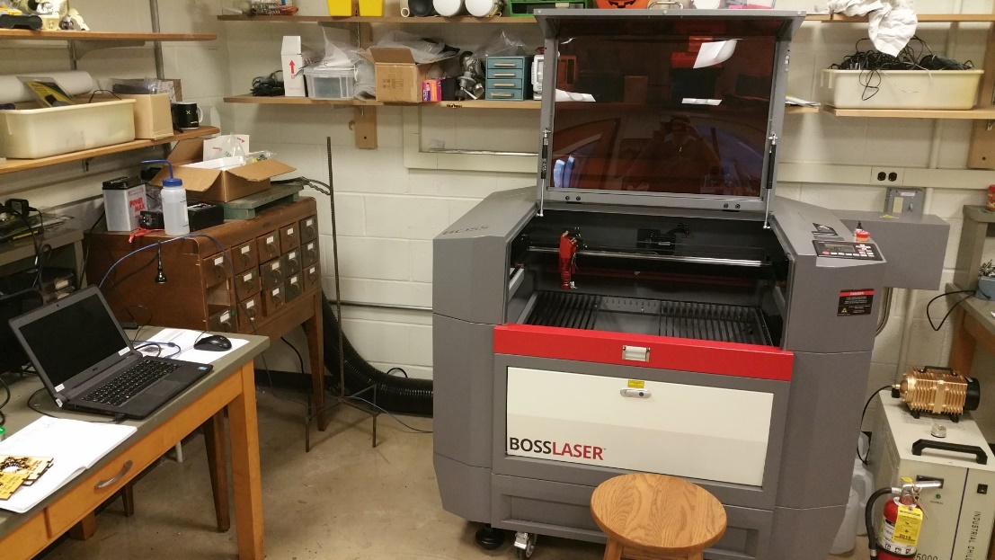
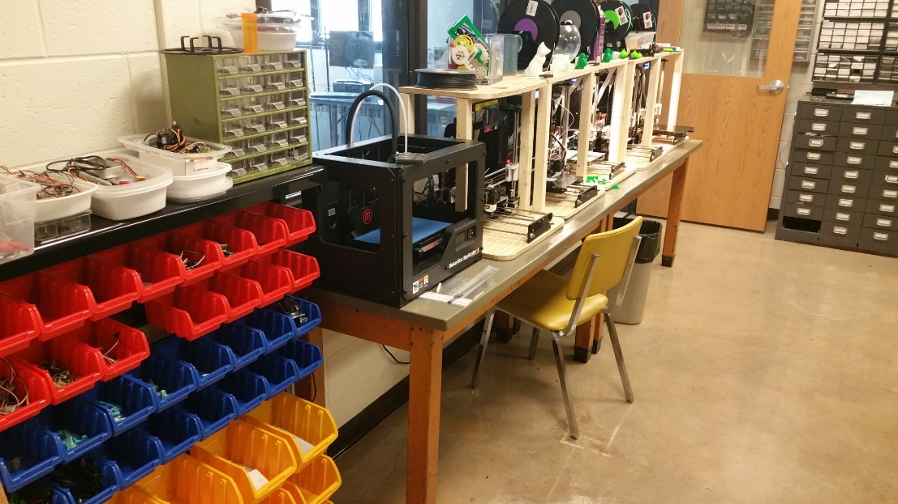
Lab Space
FISHBOWL Lab
Soldering stations
3D Printer (from kits)
100-W Boss Laser Cutter
Drill press
Toolbox
Raw materials
Advanced Science Lab and Robotic Arm Lab
https://www.youtube.com/watch?v=1uZ1uDm9kYQ
Notes:
Fabrication and Integration of Software and Hardware Bot Operations Workshop Laboratory

Slide 60
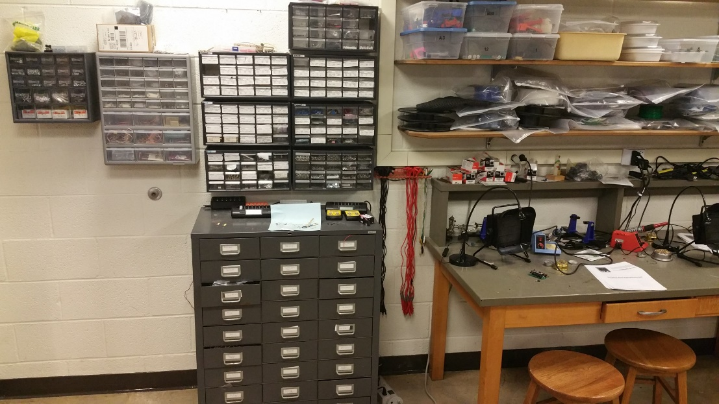
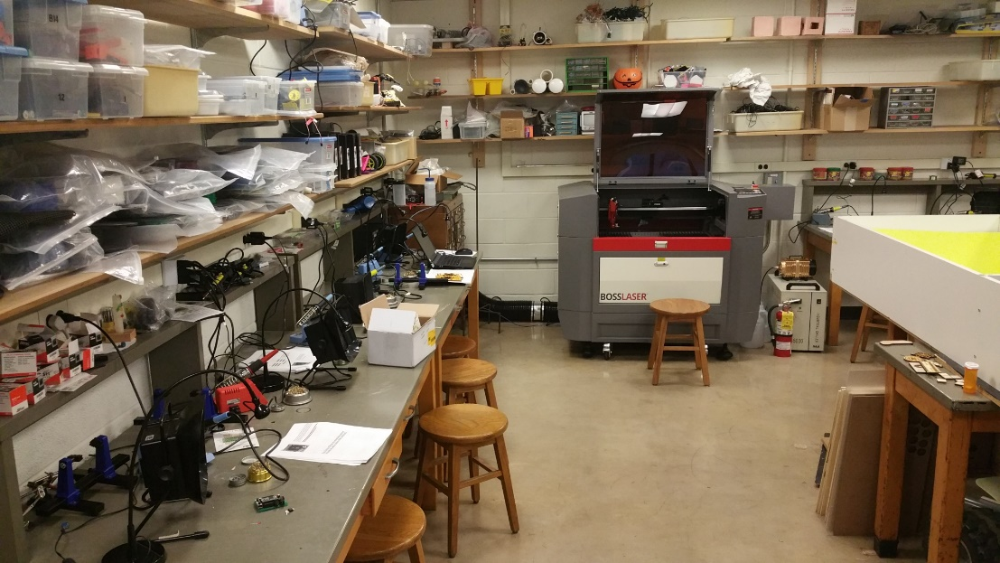
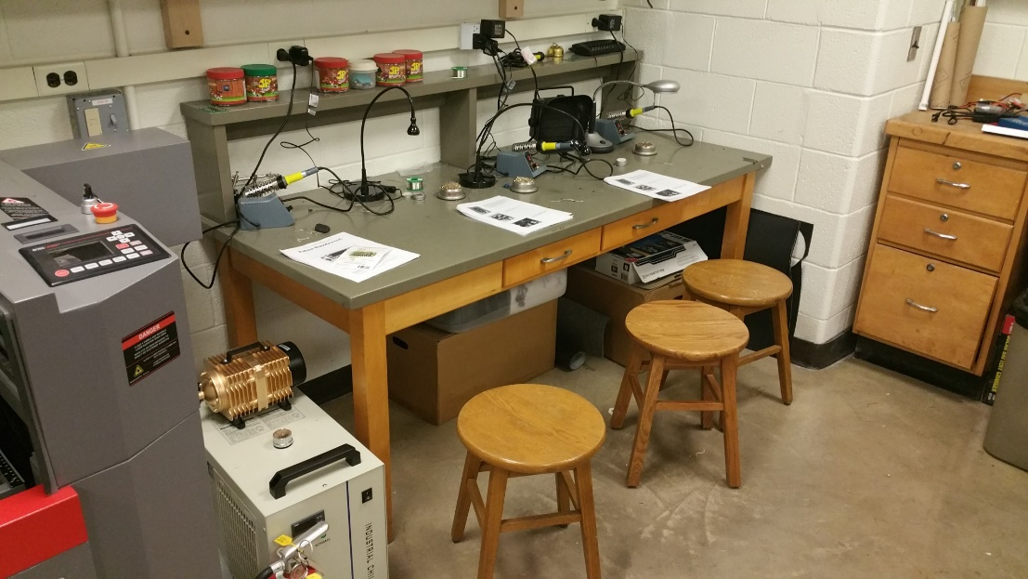
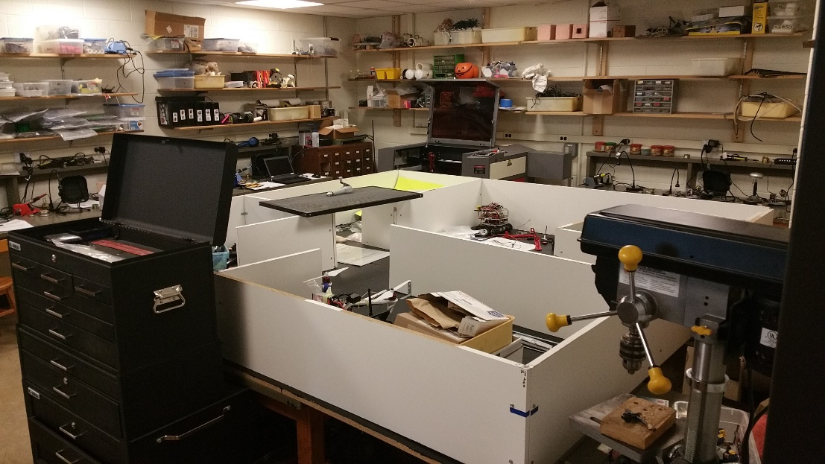
Lab Space
Notes:
Fabrication and Integration of Software and Hardware Bot Operations Workshop Laboratory

Slide 61
Fabrications Lab Skills
CAD Tutorials
SketchUp
eMachineShop
Repetier
RDWorks (PC only)
Laser Cutter intro: nameplates for toolbox shelves.
3D Printer intro: decals for toolbox identification.
Circuit Board Design and Fabrication
ExpressPCB (PC only)
Notes:
Order textbooks Day 1 (students choose B&W or color, paperback or spiral) and then we do lab skills for a week until they arrive.

Slide 62
Solder Lab Skills
Practice on sacrificial PCBs
Build two small but useful circuit boards. Patton Robotics provides boards or we make our own with ExpressPCB.
LEDs
RGB LEDs
Piezo
Pushbuttons and Switches
Line Followers
10 segment LEDs
Potentiometer boards
VDBs
Voltage probes
Hall effect probes
Etc.
PRT3 Motherboard
A big build with a few hundred solder joints
Notes:
The program grows!
Student evaluation of PRT3 solder joints

Slide 63
3D Printing
We prefer the DIY kits
Great experience for students to assemble
Easy to replace/repair
Inexpensive (especially DIY kits)
Requires careful attention and routine alignment
Have spare parts on hand
Limit filament colors
Requires CAD (SketchUp, Tinkercad, Solidworks, AutoCAD, etc…)
Requires 3D Printer Host Program (Repetier, MakerWare, etc…)

Slide 64
Laser Cutting
Very happy with our Boss LS-1630
Can not cut metal. (Our Arts department has the LS-2436, which does cut steel sheets.)
Expensive (LS-1630: ~$10K. HS-2436: ~$15K)
Requires some routine maintenance
Proper setup is critical – don’t go it alone
Super easy to use; flawless; cutting edge technology (ha, ha)
Suggest 2D drawing CAD (SketchUp, eMachineShop, e.g.)
Requires Laser Host Program (RDWorks, e.g.)

Slide 65
Final Projects 1
With luck, students finish their course work (Volume 1 and 2 assignments) by March.
The final 10 weeks of the year is then reserved for students to work on their final projects.
These can be any robotics, coding, design/art project of their own choosing. Projects must be approved.
Students may work in pairs, but they usually work alone.
The final project concludes each year with the Annual Robotics Open House the Monday before graduation. This is open to the public and is well-attended.
Notes:
Again, the internet is great for hobbyists, or if you have some prior experience, or if you know exactly what question to ask, or what specific task you need help with.
I should mention that students were involved in the process of all my books. Cover art, photography, clip art, and especially editing.

Slide 66
Final Projects 2
I am continually impressed with the quality of the work of these first year students. Here are some last year:
Amerley’s puppet: https://youtu.be/8q33-5_dZc0?t=100
Josh’s LED display: https://youtu.be/6qklIV3SK_4
Logan and David’s Hand-E: https://youtu.be/ka_jA8xFW-s?t=6
Brandon’s Line Recorder/Drawer: https://youtu.be/Vf-b2mwbh-Y?t=51
Josie’s pet bunny: https://youtu.be/-LBTJ4MI5DY
Megha’s ASL Translator: https://youtu.be/ztrL0UDUxrM

Slide 67
New Integrated Curriculum
For years, I was teaching chronologically: Start with Ch.1 and stop when you get to Ch.22. Students started with the basics of coding, and once that was done proceeded to “fun stuff” of electronics, robotics, and engineering.
I’m excited about this year’s new integrated curriculum. We now introduce the “fun stuff” much earlier, and it has been great! We still start with learning how to code, but we now introduce physical computing much earlier and integrate coding and hands-on robotics throughout the year.
Programming concepts are reinforced as topics are re-covered throughout the year.
Students like it much better – or at least this year’s students seem happier – and they are covering the material much faster. Some students are already working on their final independent project
Download my integrated curriculum here: www.pcrduino.com/resources/#curriculum.
Notes:
Again, the internet is great for hobbyists, or if you have some prior experience, or if you know exactly what question to ask, or what specific task you need help with.
I should mention that students were involved in the process of all my books. Cover art, photography, clip art, and especially editing.

Slide 68
New Integrated Curriculum Order
Software install
CAD, Laser cutter, 3D print
Ch 1. (hardware setup)
Ch 2. Serial Output
Ch 3. Variables & Data Types
Ch 4. Arithmetic
Soldering Intro
Ch 5. Functions
Solder PRT3 Motherboard
Ch 13. Electronics Intro
Ch 14. Circuits
Ch 15. Sound & Light with PRT3
Ch 7 Advanced Math (Intensive)
Ch 6. Serial Keyboard Input
Ch 8. Random Numbers
Ch 16. Sound & Light with digitalWrite()
Ch 10. Do Loops
Ch 11. For Loops
Ch 17. Sound & Light with analogWrite()
Ch 18. Servo Intro
Ch 19. Robot Motion
Ch 9. If-Then Logic
Ch 10 & 11 Re-do with Logic
Ch 20. IR Range Sensors
Ch 21. Environmental Sensing
Ch 22. Ultrasonic Range Sensors
Final Projects
Notes:
Order textbooks Day 1 (students choose B&W or color, paperback or spiral) and then we do lab skills for a week until they arrive.

Slide 69
Outside Events
Students are required to attend or compete in at least one Outside Event. This may include:
Trinity College International Robot Firefighting Competition
George School Robotics Invitational Competition
Teacher Training Workshops at George School
Admissions Open House Events
Notes:
They only buy one Teensy, unless they destroy several.

Slide 70
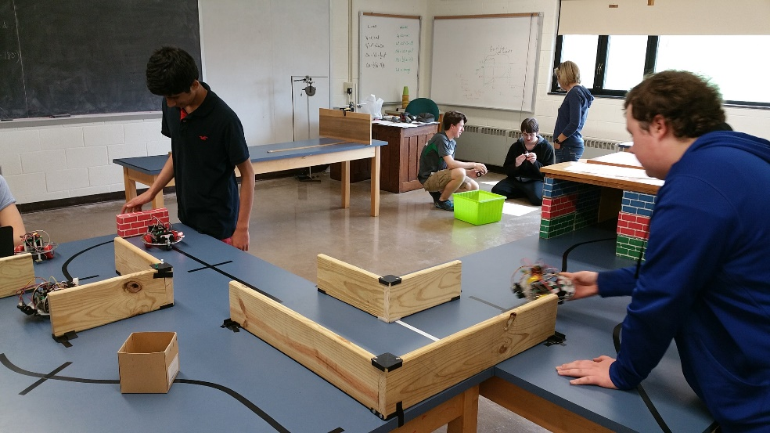
George School Robotics Invitational
No prep! Low pressure!
A robotics hack-a-thon. Great way to network.
Show up and solve as many challenges as you can in six hours.
Static and dynamic challenges.
Team and Individuals.
Interested?
Notes:
They only buy one Teensy, unless they destroy several.

Slide 71
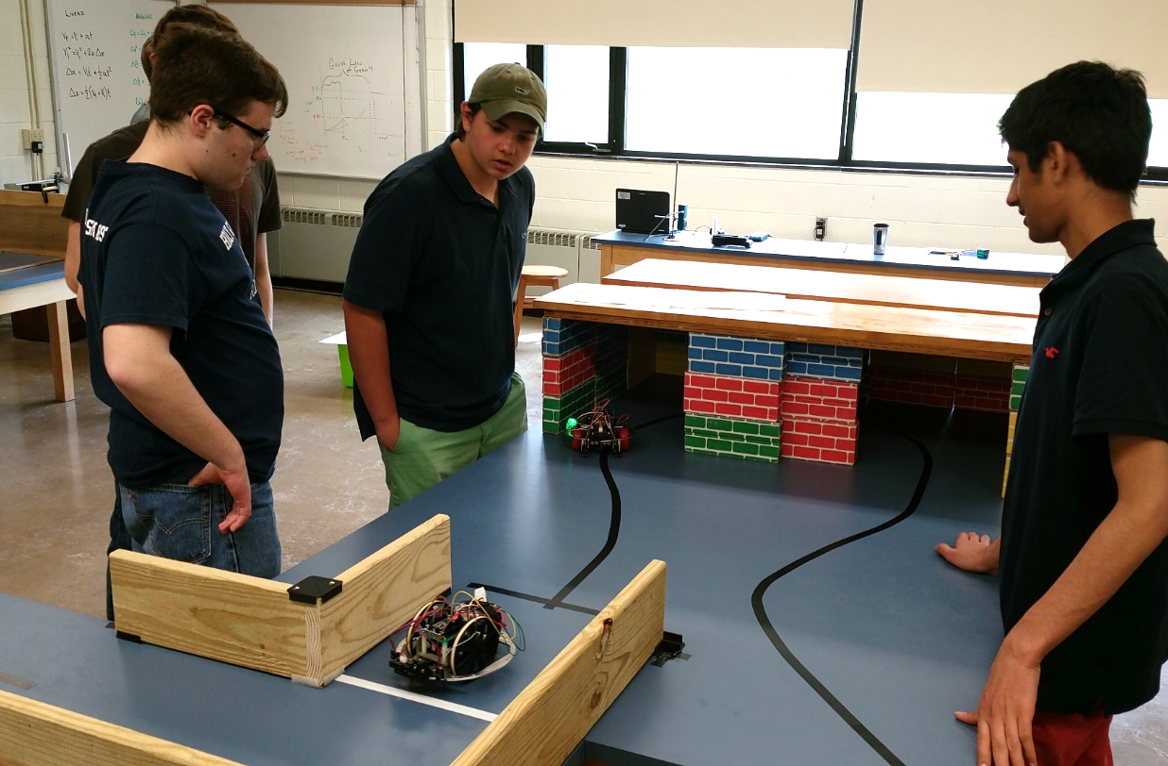
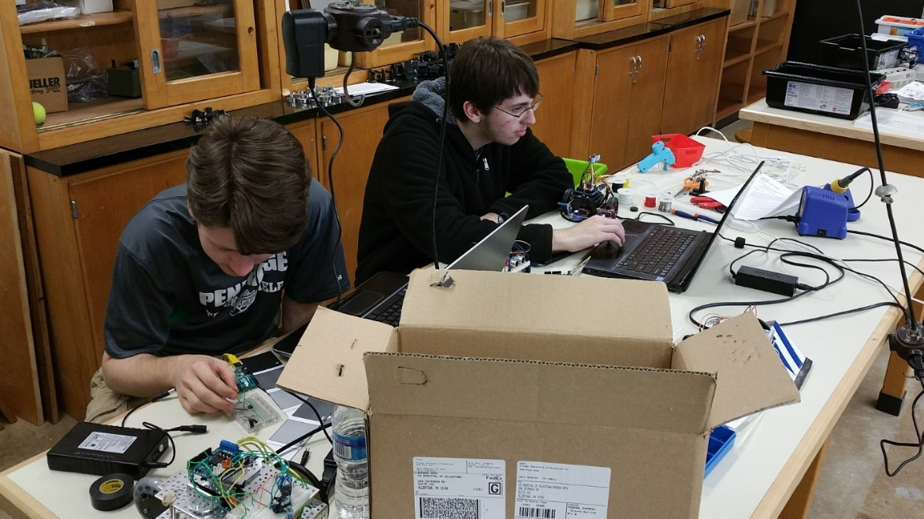
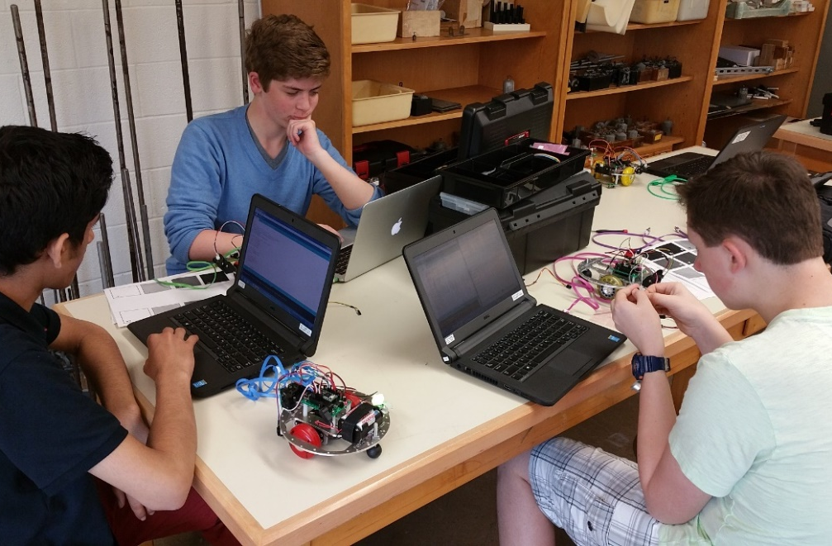
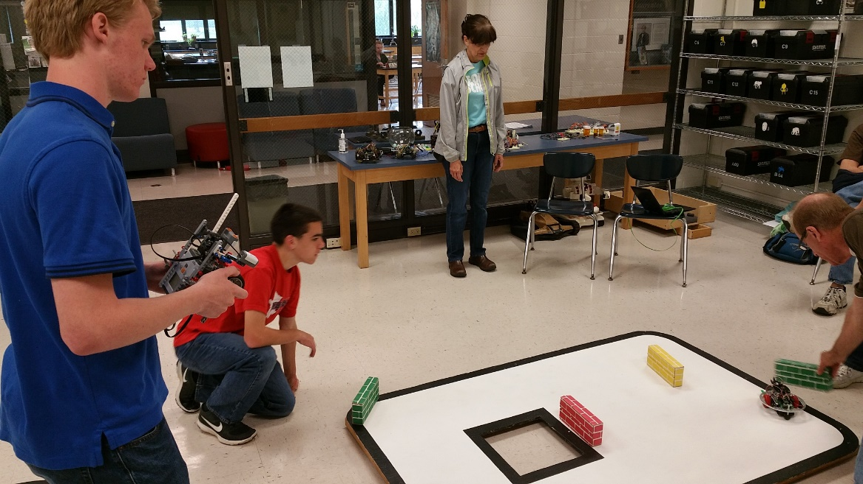
George School Robotics Invitational
Notes:
They only buy one Teensy, unless they destroy several.

Slide 72
The Future of GS Computer Science
New projects laboratory with industrial robotic arm: https://www.youtube.com/watch?v=1uZ1uDm9kYQ&list=UU18PG4C1AbRXNfd4lcFGUaw
Continue to foster minority and female involvement
Addition of AP Computer Science Principles?
IB Design Technology
Maker Space(s)?
Break into the 9th grade curriculum?

Slide 73
Final Thoughts 1
We am lucky. One day, embedded controllers will be the “boring” physics, chemistry, and biology classes of today.
We am lucky that cutting edge tech is available in high school classrooms today.
We should ride the wave of student excitement while it still fresh and new. The beauty of today’s embedded tech is that both the coding and the electronics are still accessible to the complete neophyte.

Slide 74
Final Thoughts 2
“Robotics” courses evolve. My course 17 years ago is very different today. What I teach is vastly different. This is less so in my physics courses. How I teach has certainly evolved in both classes, but the material is very different today in robotics. This is due to a number of factors.
Time = money. Over time, we have accumulated more stuff. And the more stuff, the more diverse the lessons.
The field is changing. 20 years ago, we were all excited that an embedded controller could even turn on an LED. In college and grad school, I spent months building parallel port interfaces to simply read a single voltage value with my desktop computer and to output a voltage with the same machine.
The embedded controller rapidly changed that. Now everyone can do it and do it cheaply!

Slide 75
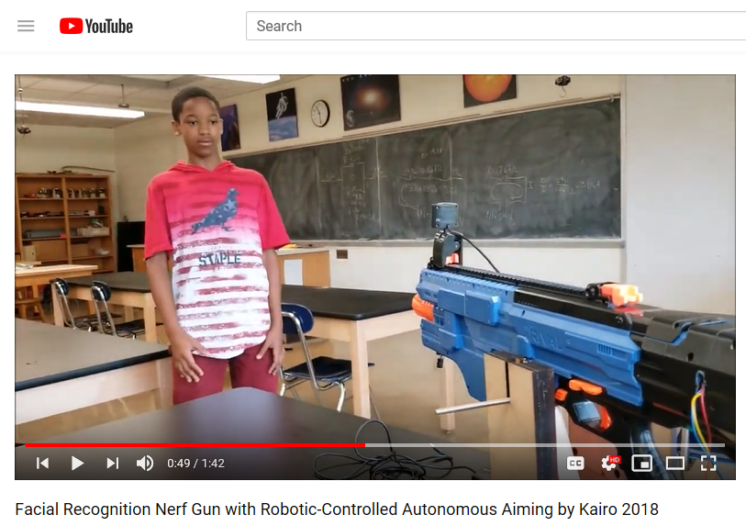
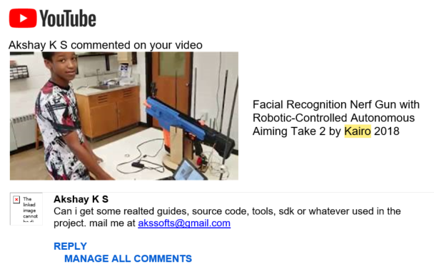
Kairo’s ethical Dilemma
https://youtu.be/-NCrX8kMbrw?t=45
https://youtu.be/5OiBJ2UivAs?t=81

Slide 76
Take-Away’s
Real coding
Real electronics
Real engineering
Real learning.
Education, not robotics.

Slide 77
Round Table Discussion
Getting students interested
Starting a course
Starting an after school program or club
Setting up a robotics lab
A STEAM curriculum
AP CS Principles
IB Design Technology
IB Computer Science
Textbooks
Competitions
Embedded Controllers in Science Classes
STEAM and other collaborations
Coding, designing, and working with/for the community. People will find you!
Issues and Opportunitiesat your schools?

Slide 78
Fabrications Lab Skills
CAD Tutorials
SketchUp
eMachineShop
Repetier
RDWorks (PC only)
Laser Cutter intro: nameplates for toolbox shelves.
3D Printer intro: decals for toolbox identification.
Circuit Board Design and Fabrication
ExpressPCB (PC only)
Notes:
Order textbooks Day 1 (students choose B&W or color, paperback or spiral) and then we do lab skills for a week until they arrive.

Slide 79
Solder Lab Skills
Practice on sacrificial PCBs
Build two small but useful circuit boards. Patton Robotics provides boards or we make our own with ExpressPCB.
LEDs
RGB LEDs
Piezo
Pushbuttons and Switches
Line Followers
10 segment LEDs
Potentiometer boards
VDBs
Voltage probes
Hall effect probes
Etc.
PRT3 Motherboard
A big build with a few hundred solder joints
Notes:
The program grows!
Student evaluation of PRT3 solder joints

Slide 80
3D Printing
We prefer the DIY kits
Great experience for students to assemble
Easy to replace/repair
Inexpensive (especially DIY kits)
Requires careful attention and routine alignment
Have spare parts on hand
Limit filament colors
Requires CAD (SketchUp, Tinkercad, Solidworks, AutoCAD, etc…)
Requires 3D Printer Host Program (Repetier, MakerWare, etc…)

Slide 81
Laser Cutting
Very happy with our Boss LS-1630
Can not cut metal. (Our Arts department has the LS-2436, which does cut steel sheets.)
Expensive (LS-1630: ~$10K. HS-2436: ~$15K)
Requires some routine maintenance
Proper setup is critical – don’t go it alone
Super easy to use; flawless; cutting edge technology (ha, ha)
Suggest 2D drawing CAD (eMachineShop, e.g.)
Requires Laser Host Program (RDWorks, e.g.)

Slide 82
Final Projects 1
With luck, students finish their course work (Volume 1 and 2 assignments) by March.
The final 10 weeks of the year is then reserved for students to work on their final projects.
These can be any robotics, coding, design/art project of their own choosing. Projects must be approved.
Students may work in pairs, but they usually work alone.
The final project concludes each year with the Annual Robotics Open House the Monday before graduation. This is open to the public and is well-attended.
Notes:
Again, the internet is great for hobbyists, or if you have some prior experience, or if you know exactly what question to ask, or what specific task you need help with.
I should mention that students were involved in the process of all my books. Cover art, photography, clip art, and especially editing.

Slide 83
Final Projects 2
I am continually impressed with the quality of the work of these first year students. Here are some last year:
Amerley’s puppet: https://youtu.be/8q33-5_dZc0?t=100
Josh’s LED display: https://youtu.be/6qklIV3SK_4
Logan and David’s Hand-E: https://youtu.be/ka_jA8xFW-s?t=6
Brandon’s Line Recorder/Drawer: https://youtu.be/Vf-b2mwbh-Y?t=51
Josie’s pet bunny: https://youtu.be/-LBTJ4MI5DY
Megha’s ASL Translator: https://youtu.be/ztrL0UDUxrM

Slide 84
New Integrated Curriculum
For years, I was teaching chronologically: Start with Ch.1 and stop when you get to Ch.22. Students started with the basics of coding, and once that was done proceeded to “fun stuff” of electronics, robotics, and engineering.
I’m excited about this year’s new integrated curriculum. We now introduce the “fun stuff” much earlier, and it has been great! We still start with learning how to code, but we now introduce physical computing much earlier and integrate coding and hands-on robotics throughout the year.
Programming concepts are reinforced as topics are re-covered throughout the year.
Students like it much better – or at least this year’s students seem happier – and they are covering the material much faster. Some students are already working on their final independent project
Download my integrated curriculum here: www.pcrduino.com/resources/#curriculum.
Notes:
Again, the internet is great for hobbyists, or if you have some prior experience, or if you know exactly what question to ask, or what specific task you need help with.
I should mention that students were involved in the process of all my books. Cover art, photography, clip art, and especially editing.

Slide 85
New Integrated Curriculum Order
Software install
CAD, Laser cutter, 3D print
Ch 1. (hardware setup)
Ch 2. Serial Output
Ch 3. Variables & Data Types
Ch 4. Arithmetic
Soldering Intro
Ch 5. Functions
Solder PRT3 Motherboard
Ch 13. Electronics Intro
Ch 14. Circuits
Ch 15. Sound & Light with PRT3
Ch 7 Advanced Math (Intensive)
Ch 6. Serial Keyboard Input
Ch 8. Random Numbers
Ch 16. Sound & Light with digitalWrite()
Ch 10. Do Loops
Ch 11. For Loops
Ch 17. Sound & Light with analogWrite()
Ch 18. Servo Intro
Ch 19. Robot Motion
Ch 9. If-Then Logic
Ch 10 & 11 Re-do with Logic
Ch 20. IR Range Sensors
Ch 21. Environmental Sensing
Ch 22. Ultrasonic Range Sensors
Final Projects
Notes:
Order textbooks Day 1 (students choose B&W or color, paperback or spiral) and then we do lab skills for a week until they arrive.

Slide 86
Outside Events
Students are required to attend or compete in at least one Outside Event. This may include:
Trinity College International Robot Firefighting Competition
George School Robotics Invitational Competition
Teacher Training Workshops at George School
Admissions Open House Events
Notes:
They only buy one Teensy, unless they destroy several.

Slide 87
George School Robotics Invitational
No prep! Low pressure!
A robotics hack-a-thon. Great way to network.
Show up and solve as many challenges as you can in six hours.
Static and dynamic challenges.
Team and Individuals.
Interested?
Notes:
They only buy one Teensy, unless they destroy several.

Slide 88
George School Robotics Invitational
Notes:
They only buy one Teensy, unless they destroy several.

Slide 89
The Future of GS Computer Science
New projects laboratory with industrial robotic arm: https://www.youtube.com/watch?v=1uZ1uDm9kYQ&list=UU18PG4C1AbRXNfd4lcFGUaw
Continue to foster minority and female involvement
Addition of AP Computer Science Principles?
IB Design Technology
Maker Space(s)?
Break into the 9th grade curriculum?

Slide 90
Final Thoughts 1
I am lucky. One day, embedded controllers will be the “boring” physics, chemistry, and biology classes of today.
I am lucky that cutting edge tech is available in high school classrooms today.
We should ride the wave of student excitement while it still fresh and new. The beauty of today’s embedded tech is that both the coding and the electronics are still accessible to the complete neophyte.

Slide 91
Final Thoughts 2
“Robotics” courses evolve. My course 17 years ago is very different today. What I teach is vastly different. This is less so in my physics courses. How I teach has certainly evolved in both classes, but the material is very different today in robotics. This is due to a number of factors.
Time = money. Over time, we have accumulated more stuff. And the more stuff, the more diverse the lessons.
The field is changing. 20 years ago, we were all excited that an embedded controller could even turn on an LED. In college and grad school, I spent months building parallel port interfaces to simply read a single voltage value with my desktop computer and to output a voltage with the same machine.
The embedded controller rapidly changed that. Now everyone can do it and do it cheaply!

Slide 92
Kairo’s ethical Dilemma
https://youtu.be/-NCrX8kMbrw?t=45
https://youtu.be/5OiBJ2UivAs?t=81

Slide 93
Take-Away’s
Real coding
Real electronics
Real engineering
Real learning.
Education, not robotics.

Slide 94
Round Table Discussion
Getting students interested
Starting a course
Starting an after school program or club
Setting up a robotics lab
A STEAM curriculum
AP CS Principles
IB Design Technology
IB Computer Science
Textbooks
Competitions
Embedded Controllers in Science Classes
STEAM and other collaborations
Coding, designing, and working with/for the community. People will find you!
Issues and Opportunitiesat your schools?

Slide 95
